Slide 1
Smart Home Energy Consumption Prediction Using Machine Learning
Time Series Analysis and Cloud Deployment on AWS EC2

Slide 2
Problem Statement & Motivation
Household electricity consumption varies significantly over time
Accurate prediction helps improve:
Energy efficiency
Smart home automation
Cost optimization
Problem Definition
The goal of this project is to predict household electricity consumption using historical power usage data.

Slide 3
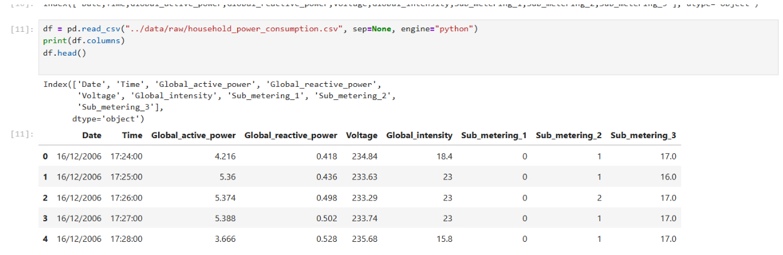
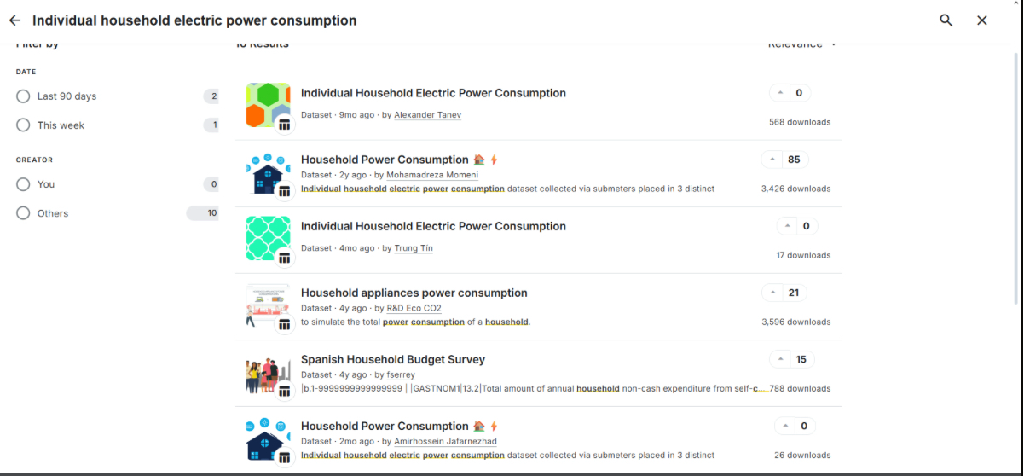
Dataset Description
Dataset:
Public dataset from Kaggle
Individual Household Electric Power Consumption
Minute-level measurements
Features:
Global active power
Voltage
Global intensity
Sub-metering values

Slide 4

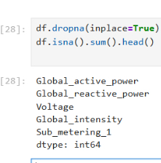
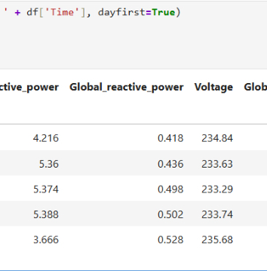
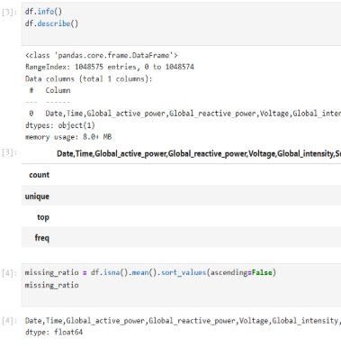
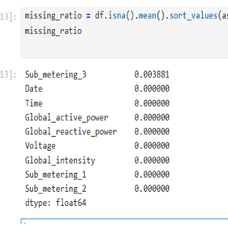
Data Preprocessing
Steps applied:
Dataset inspection using df.info() and df.describe()
Missing value analysis
Removal of missing values using dropna()
Creation of datetime index from Date and Time columns

Slide 5
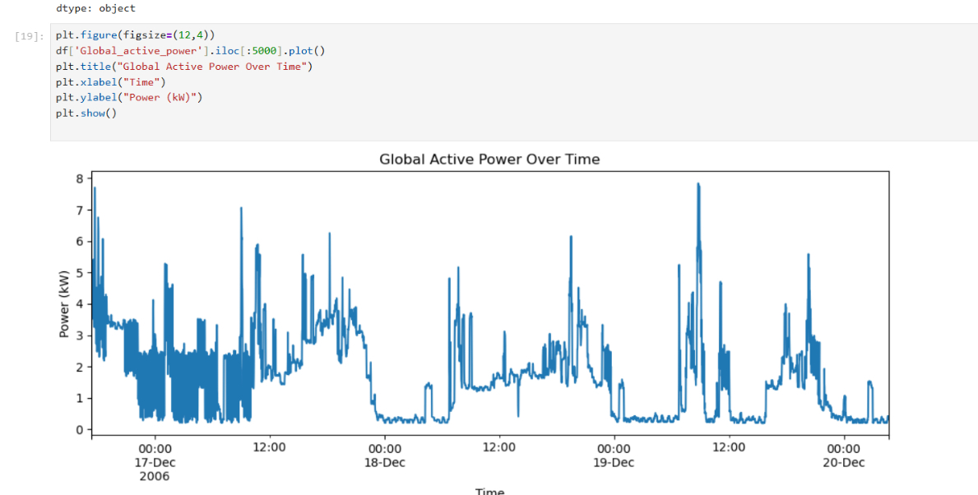
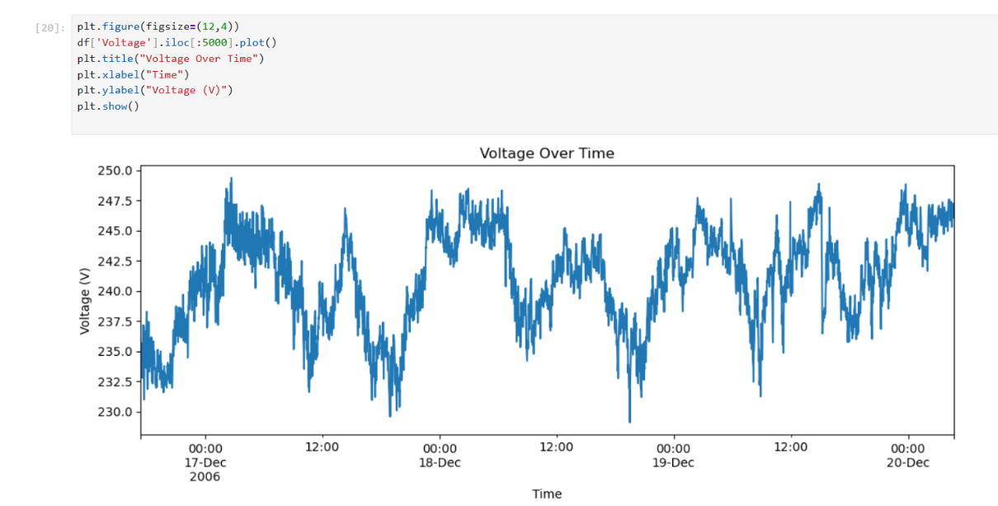
Exploratory Data Analysis (EDA)
Observations:
Power consumption shows strong daily patterns
Voltage fluctuates within a stable range
Clear peaks during high-usage periods

Slide 6
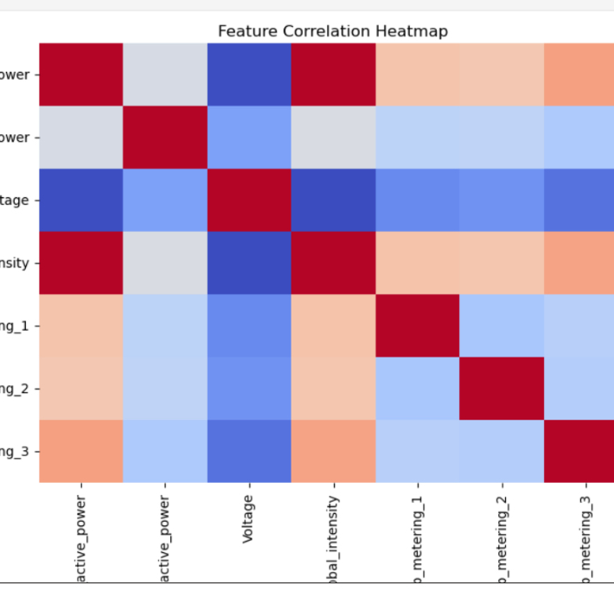
Feature Correlation Analysis
Correlation Insights:
Global intensity strongly correlates with active power
Sub-metering values show moderate relationships
Voltage has weaker correlation with power consumption

Slide 7
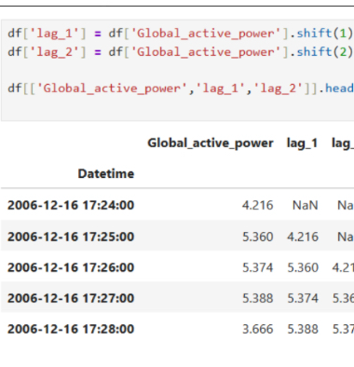
Feature Engineering
Additional Features:
Lag-based features created:
lag_1 (previous time step)
lag_2 (two time steps back)
Purpose:
Capture temporal dependency in time series data

Slide 8
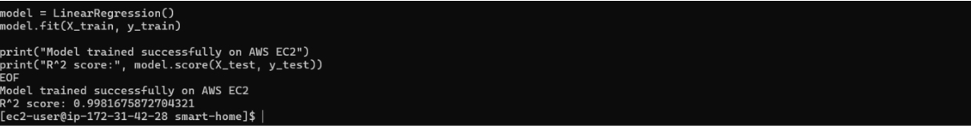
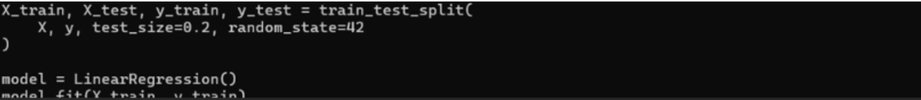
Model Development
Model Used:
Linear Regression (baseline model)
Training Process:
Train-test split (80% / 20%)
Input features:
Voltage
Global intensity
Target variable:
Global active power

Slide 9
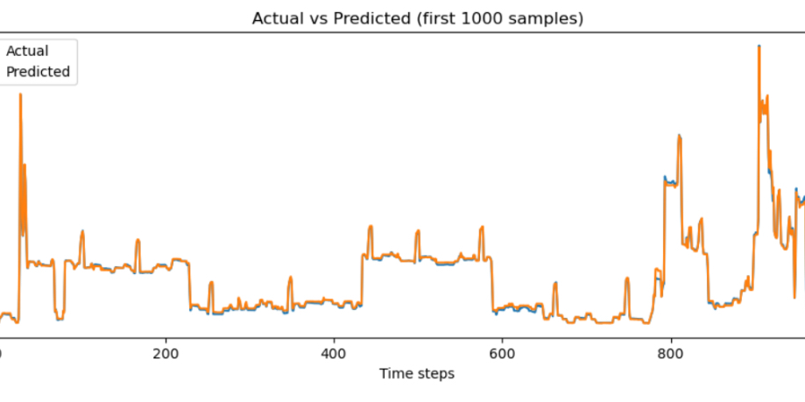
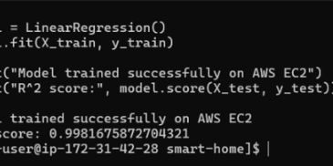
Model Evaluation
Evaluation Metric:
R² Score
Results:
R² ≈ 0.99
Predictions closely match actual values

Slide 10
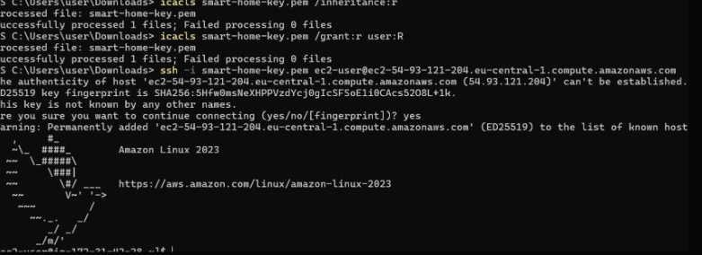
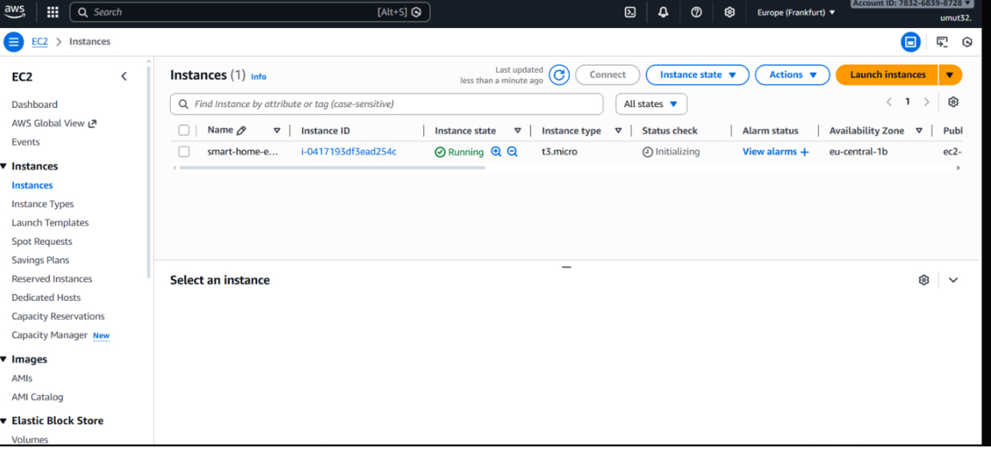
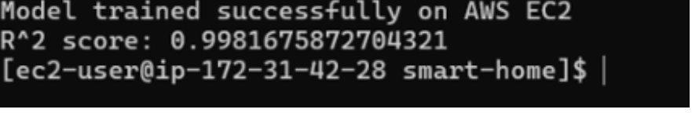
Cloud Deployment (AWS EC2)
Deployment Details:
Model executed on AWS EC2 Free Tier
Linux-based EC2 instance
SSH connection used for remote execution

Slide 11
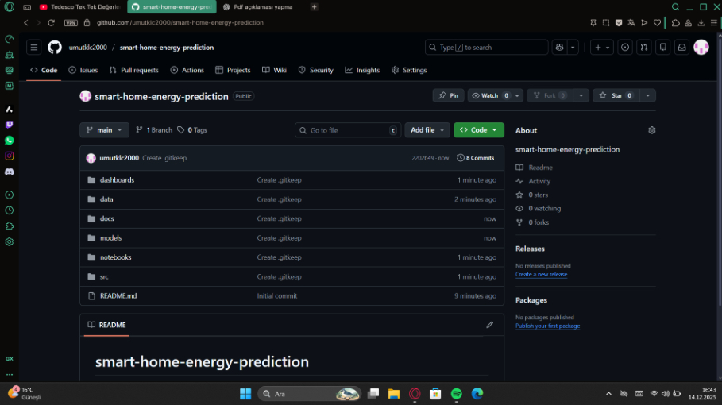
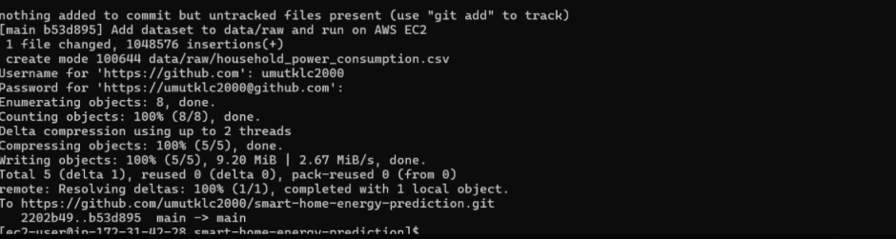
GitHub Repository
Repository Structure:
Clean and organized codebase
data/, docs/, and source code folders
README documentation included
Version Control:
Dataset and code pushed to GitHub
Reproducible project structure

Slide 12
Conclusion & Future Work
Conclusion:
Successfully built an end-to-end ML pipeline
High prediction accuracy achieved
Cloud deployment completed
Future Improvements:
Try advanced models (LSTM, XGBoost)
Deploy as a web application (Streamlit)
Add real-time prediction support

